Slide 1

2. Markov Decision Processes
COMP 7404
Computational Intelligence and Machine Learning
Dirk Schnieders
Most materials in this chapter are based on materials from http://aima.cs.berkeley.edu/ and http://ai.berkeley.edu

Slide 2
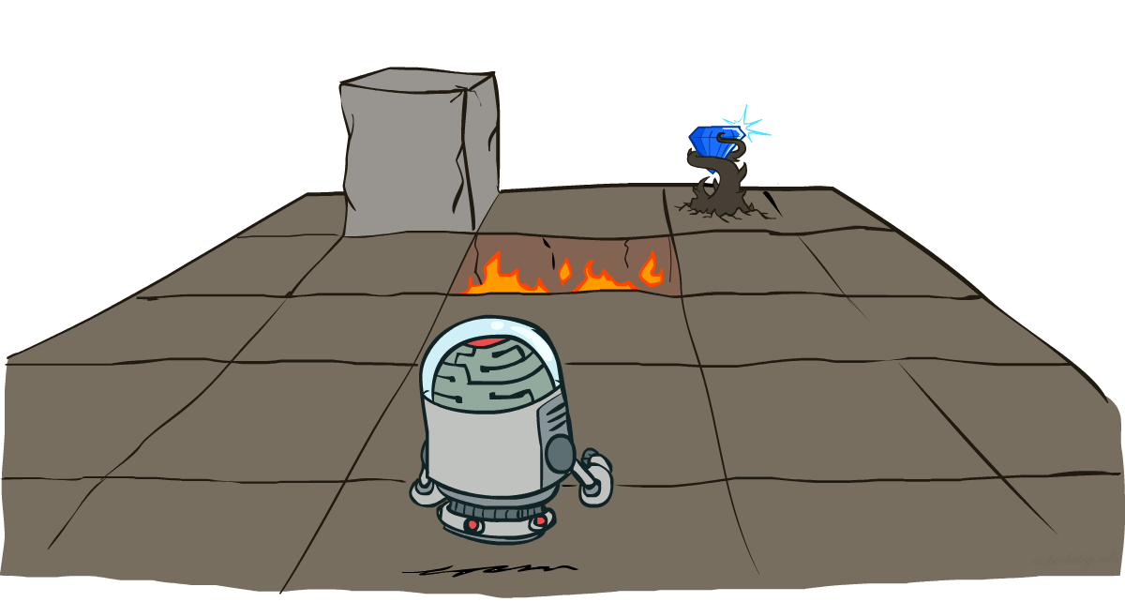
Sequential Decision Problem
In a sequential decision problem the agent’s utility depends on a sequence of decisions
Sequential decision problems incorporate utilities, uncertainty and sensing
Optimal behavior balances the risks and rewards of acting in an uncertain environment
http://ai.berkeley.edu

Slide 3
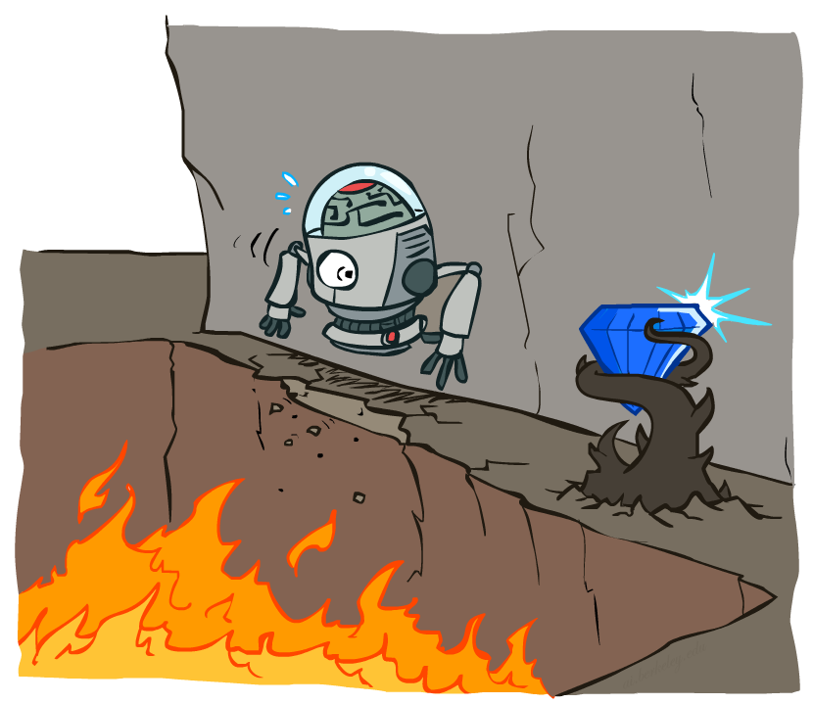
Non-Deterministic Search
http://ai.berkeley.edu
Notes:
Actions are stochastic

Slide 4
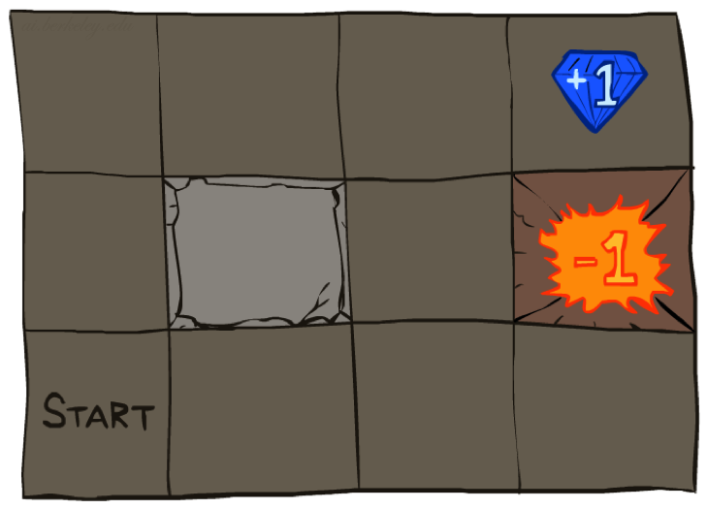

Running Example: Grid World
Exit state
Intended direction
Wall
Exit state
Current agent location
Start state
http://ai.berkeley.edu
Unintended direction
Unintended direction

Slide 5
Grid World
Example of stochastic motion:
Intended direction is north
0.8
Maze-like problem
Agent lives in a grid
Walls block the agent’s path
Unreliable actions
Each action achieves the intended effect 80% of the time
10% of the time the action moves the agent at right angles (i.e., 90°) to the intended direction
If the agent bumps into a wall it stays in the same square
The agent receives rewards for each action
Small “living” rewards (can be negative)
Big rewards come at the end (good or bad)
Goal states
+1 and -1 are goal states
Only action available: exit action
Goal: maximize sum of rewards
0.1
0.1
 |  |  | +1
 |  |  | -1

Slide 6
Deterministic vs. stochastic motion
 |  |  | +1
 |  |  | -1
 |  |  | +1
 |  |  | -1
1.0
0.8
0.0
0.0
0.1
0.1
 |  |  | +1
 |  |  | -1
 |  |  | +1
 |  |  | -1
 |  |  | +1
 |  |  | -1
 |  |  | +1
0.1
0.8
0.1

Slide 7
Example episode in grid world
Reward (R): -0.1 per action
 |  |  | +1
 |  |  | -1
 |  |  | +1
 |  |  | -1
 |  |  | +1
 |  |  | -1
 |  |  | +1
 |  |  | -1
R: 0
R: -.1
R: -.2
R: -.3
 |  |  | +1
 |  |  | -1
 |  |  | -1
 |  |  | +1
 |  |  | -1
 |  |  | +1
 |  |  | -1
R: .4
R: -.6
R: -.5
R: -.4
exit

Slide 8
Quiz - North North
Consider the fixed action sequence [North, North]
What is the probability of reaching the highlighted state from the start state with this action sequence?
 |  |  | +1
 |  |  | -1
0.8
0.1
0.1

Slide 9
Quiz - East East
Which squares can be reached from the start state by the action sequence [East, East] and with what probabilities?
 |  |  | +1
 |  |  | -1

Slide 10
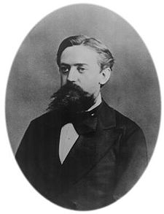
Transition model
The transition model T(s,a,s’) describes the outcome of each action in each state
The outcome is stochastic and we write P(s’|s,a) to denote the probability of reaching state s’ if action a is done in state s
We assume that transitions are Markovian
I.e., the probability of reaching s’ from s depends only on s and not on the history of earlier states
The Markov property is named after the Russian mathematician Andrey Markov
source
Andrey Markov (1856-1922)

Slide 11
Markov Decision Processes
A sequential decision problem for a fully observable, stochastic environment with a Markovian transition model and additive rewards is called a Markov decision process (MDP)
It is defined by
A set of states s ∊ S
A set of actions a ∊ A
A transition function T(s,a,s’)
Probability that action a from s leads to s’, i.e., P(s’|s,a)
A reward function R(s,a,s’)
A start state s₀
A terminal state (optional)

Slide 12
What is the solution to an MDP?
A fixed action sequence?

Slide 13
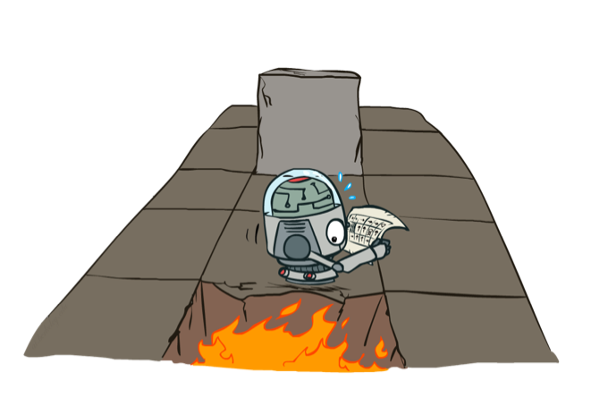
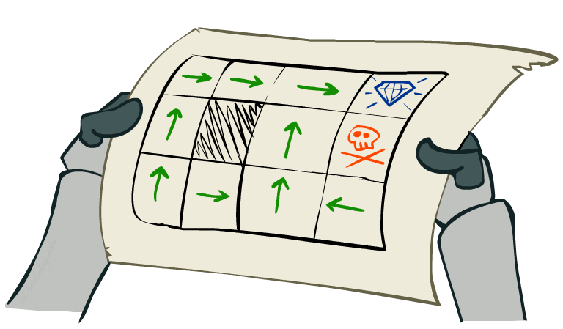
Policy
How to solve MDPs?
A fixed action sequence won’t solve the problem because the agent might end up in a state other than the goal
A solution must specify what the agent should do for any state that the agent might reach
A solution of this kind is called a policy π
π(s) is the action recommended by the policy π for the state s
http://ai.berkeley.edu
http://ai.berkeley.edu

Slide 14
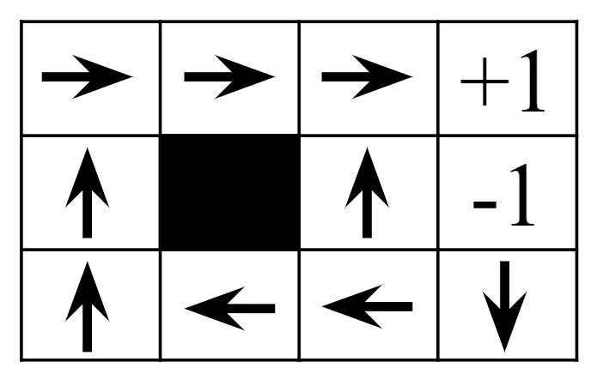
Optimal Policy
Each time a given policy is executed, the stochastic nature of the environment may lead to a different environment history
The quality of a policy is therefore measured by the expected utility of the possible environment histories generated by that policy
An optimal policy π* is a policy that yields the highest expected utility
Example: π* for Grid World with R(s) = -0.04 (∀ nonterminal s)

Slide 15
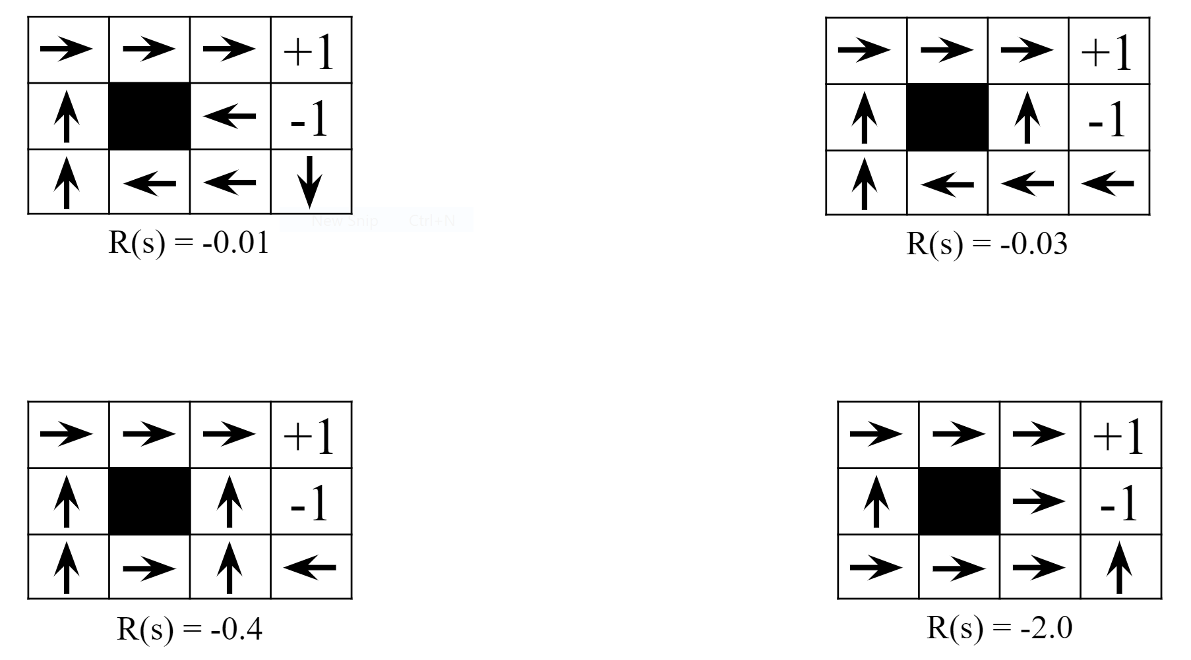
Optimal Policy - Example

Slide 16
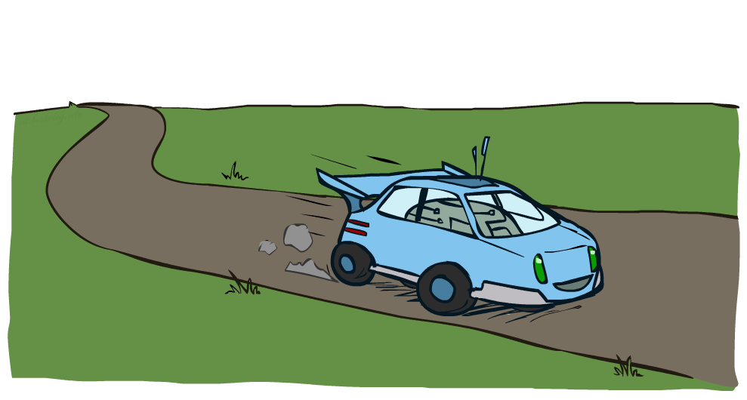
Example: Racing Car
http://ai.berkeley.edu

Slide 17
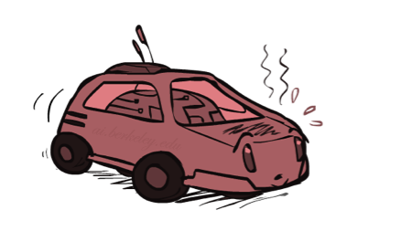
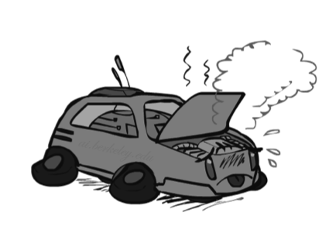
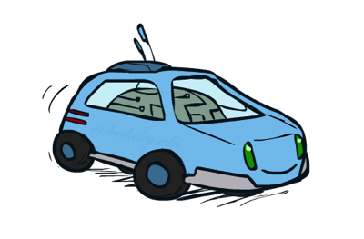
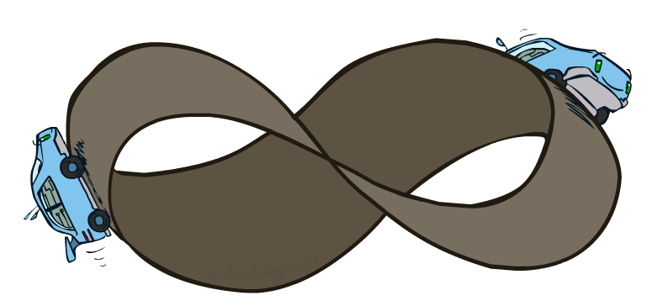
Example: Racing Car
A robot car wants to travel far, quickly
Three states: Cool, Warm, Overheated
Two actions: Slow (+1), Fast (+2)
-10
+2
+1
+1
http://ai.berkeley.edu

Slide 18
Racing Search Tree
http://ai.berkeley.edu
...
...
...
...
...
...
...
...

Slide 19

MDP Search Tree
Each MDP state projects an expectimax-like search tree
s is a state
s
a is an action
a
s,a is a q state
s,a
(s,a,s’) is a transition
T(s,a,s’) = P(s’|s,a)
R(s,a,s’) is the reward
associated with the transition
s,a,s’
s’
s’ is the resulting state

Slide 20
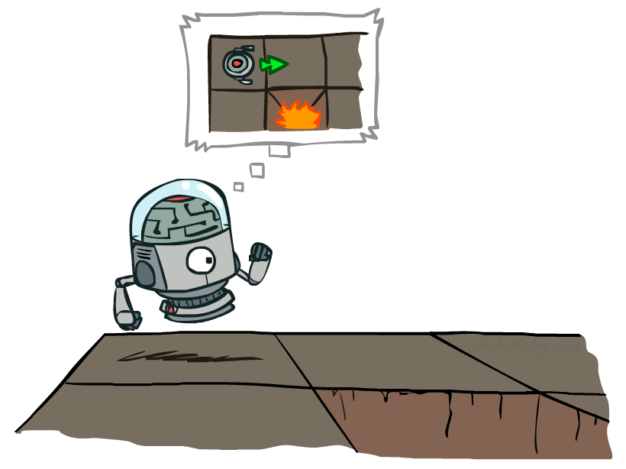
Q state
The agent has committed to the action but has not done it yet
s
a
s,a is a q state
s,a
s,a,s’
s’
http://ai.berkeley.edu

Slide 21
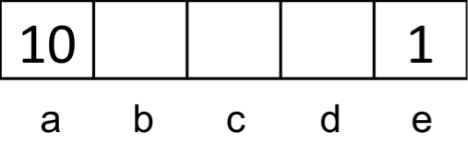
Quiz - Notation
Consider a grid world MDP as shown above
The available actions in each state are to move to the neighboring grid squares
East and west actions are successful 80% of the time
When not successful, the agent stays in place
From state a, there is also an exit action available, which results in going to the terminal state and collecting a reward of 10
Similarly, in state e, the reward for the exit action is 1
Exit actions are successful 100% of the time
Find the following quantities
T(c,East,d)
T(c,East,e)
T(c,East,c)
T(c,East,b)
T(c,East,a)
T(c,East,terminal state)
T(a,Exit,terminal state)
T(a,East,b)
T(a,East,a)
R(a,East,a)
R(a,Exit,terminal state)
R(c,East,d)

Slide 22
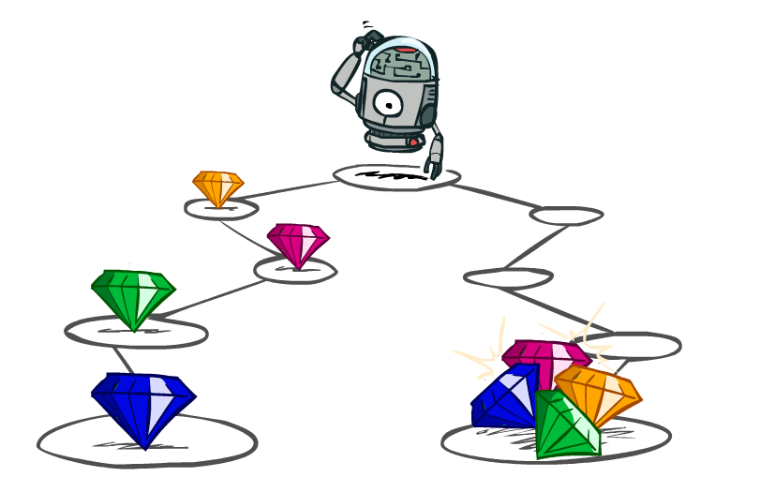
Utility of State Sequences
http://ai.berkeley.edu

Slide 23
Utility of State Sequences
How to calculate the utility of state sequences?
What preferences should an agent have over reward sequences?
More or less?
[1, 2, 2] or [2, 3, 4]
Now or later?
[0, 0, 1] or [1, 0, 0]
http://ai.berkeley.edu

Slide 24




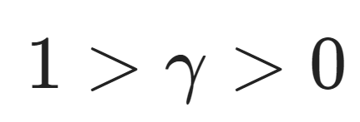
Discounting
It’s reasonable to maximize the sum of rewards
It’s also reasonable to prefer rewards now to rewards later
One solution
Values of rewards decay exponentially
http://ai.berkeley.edu
Worth Now
Worth one step from now
Worth two step from now

Slide 25
Quiz - [1,2,3] vs. [3,2,1]
Consider the sequences [1,2,3] and [3,2,1]
Let γ = 0.5, which sequence has a higher utility?

Slide 26
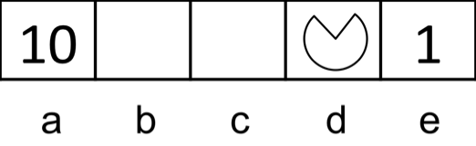
Quiz - Optimal Action 1
Consider the same grid world MDP as in one of the previous quiz
Let actions always be successful
Let the discount factor be γ = 0.1
Q1: What is the optimal action in the state d ?
Now let the discount factor be γ = 0.9999
Q2: What is the optimal action in the state d ?

Slide 27
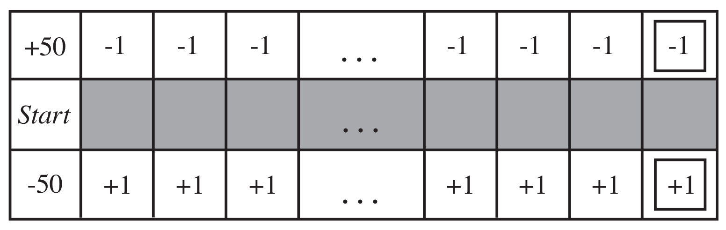
Quiz - Optimal Action 2
Consider the following 101 x 3 world
In the start state, the agent has a choice of two deterministic actions up or down but in the other states the agent has one deterministic action
Assuming a discounted reward function, for what values of γ will the agent choose up ?
Compute the utility of each action as a function of γ

Slide 28
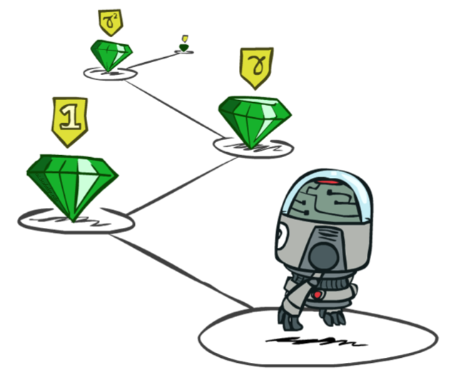


Stationary Preferences
We assume an agent’s preferences between state sequences are stationary
If two state sequences begin with the same state r, then the two sequences should be preference-ordered the same way as the sequences without r
http://ai.berkeley.edu

Slide 29
Stationary Preferences
Stationarity has strong consequences
It turns out that there are just two coherent ways to assign utilities to sequences
Additive rewards
Discounted rewards

Slide 30
Quiz - Stationary Preference
Suppose that we define the utility of a state sequence to be the maximum reward obtained in any state in the sequence
Does this utility function result in stationary preference between state sequences?

Slide 31
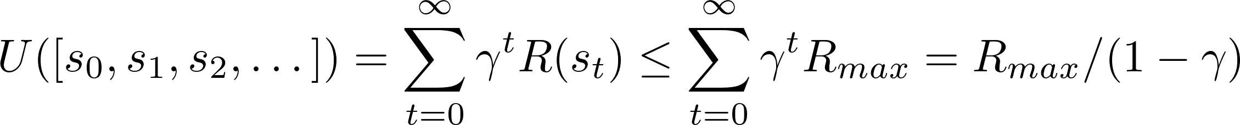
Infinity Utilities?
http://ai.berkeley.edu
What if the environment does not contain a terminal state or if the agent never reaches one?
Utilities with additive undiscounted rewards will be infinite
E.g., Race game
The smart race car will never overheat
With discounted rewards, the utility of an infinite sequence is finite

Slide 32
Optimal Quantities
V*(s) is the value (utility) of a state s
Expected utility starting in s and acting optimally
Q*(s,a) is the value (utility) of a q-state (s,a)
Expected utility for having taken action a from state s and thereafter acting optimally
π*(s) is the optimal policy for state s
I.e., optimal action from state s
s
a
s,a
s,a,s’
s’

Slide 33
Example - π* and V*
exit
0.64
0.74
0.85
1.00
exit
0.57
0.57
-1.00
0.49
0.43
0.48
0.28

Slide 34
Example - Q*
0.59
0.67
0.77
exit
0.57
0.64
0.60
0.74
0.66
0.85
1.00
0.53
0.67
0.57
0.57
0.57
exit
0.51
0.51
0.53
-0.60
-1.00
0.46
0.30
0.49
0.40
0.48
-0.65
0.45
0.41
0.43
0.42
0.40
0.29
0.28
0.13
0.44
0.40
0.41
0.27

Slide 35
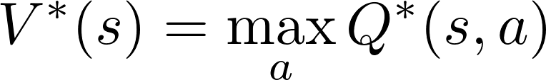
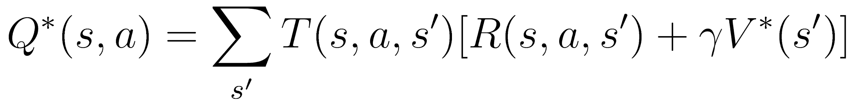
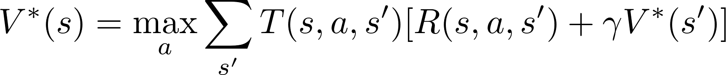
Bellman Equation
How to compute the value of a state?
Average sum of discounted action
Very similar to expectimax
Recursive definition
s
a
s,a
s,a,s’
s’

Slide 36
Racing Search Tree
http://ai.berkeley.edu
What is the value of this state?
Can we use expectimax to calculate it?
No, too slow ...
...
...
...
...
...
...
...
...

Slide 37
Racing Search Tree
Problems
States are repeated (even at same depth)
Tree goes on forever
Idea
Do a depth-limited computation, but with increasing depths until change is small
Note: Deep parts of the tree eventually don’t matter if γ < 1
Solution
Only compute needed quantities once
Do a depth-limited computation, but with increasing depths until change is small

Slide 38

Time-Limited Values
Define V_{k}(s) to be the optimal value of s if the game ends in k more time steps (k more rewards)
Equivalently, it’s what a depth-k expectimax would give from s
V₂( )

Slide 39
Example - V₀
0.00
0.00
0.00
0.00
0.00
0.00
0.00
R(s) = 0.00
𝛄 = 0.99
0.00
0.00
0.00
0.00

Slide 40
Example - V₁
0.00
0.00
0.00
1.00
0.00
0.00
-1.00
R(s) = 0.00
𝛄 = 0.99
0.00
0.00
0.00
0.00

Slide 41
Example - V₂
= 0.8 * 0.99 * 1.00
0.00
0.00
0.79
1.00
0.00
0.00
-1.00
R(s) = 0.00
𝛄 = 0.99
0.00
0.00
0.00
0.00

Slide 42
Example - V₃
= 0.8 * 0.99 * 0.79
= 0.8 * 0.99 * 1.0 + 0.1 * 0.99 * 0.79
0.00
0.63
0.87
1.00
= 0.1 * 0.99 * -1.00 + 0.8 * 0.99 * 0.79
0.00
0.53
-1.00
R(s) = 0.00
𝛄 = 0.99
0.00
0.00
0.00
0.00

Slide 43
Example - V₄
0.50
0.81
0.93
1.00
0.00
0.64
-1.00
R(s) = 0.00
𝛄 = 0.99
0.00
0.00
0.42
0.00

Slide 44
Example - V₅
0.69
0.90
0.95
1.00
0.39
0.70
-1.00
R(s) = 0.00
𝛄 = 0.99
0.00
0.33
0.51
0.23

Slide 45
Example - V₆
0.82
0.93
0.96
1.00
0.63
0.72
-1.00
R(s) = 0.00
𝛄 = 0.99
0.34
0.47
0.61
0.33

Slide 46
Example - V₇
0.88
0.94
0.96
1.00
0.77
0.73
-1.00
R(s) = 0.00
𝛄 = 0.99
0.58
0.58
0.65
0.42

Slide 47
Example - V₁₀₀
0.95
0.97
0.98
1.00
0.94
0.89
-1.00
R(s) = 0.00
𝛄 = 0.99
0.93
0.92
0.90
0.82

Slide 48
Computing Time-Limited Values
We can save a lot of computation
Example:
At every layer we have to compute at most 3 time limited values
V₂( )
V₁( )
V₁( )
V₀( )
V₀( )
V₀( )
http://ai.berkeley.edu

Slide 49
Quiz - Time-Limited Values
Consider the same grid world MDP as in the previous quiz
Actions are successful 100% of the time
γ = 1
Determine in the following quantities
V₀(d)
V₁(d)
V₂(d)
V₃(d)
V₄(d)
V₅(d)

Slide 50
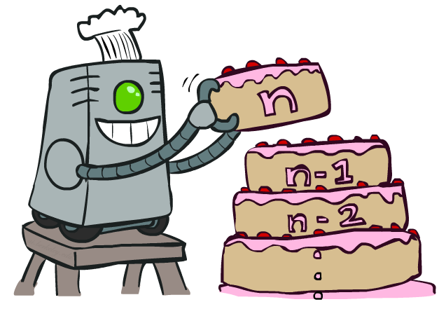
Value Iteration
http://ai.berkeley.edu

Slide 51
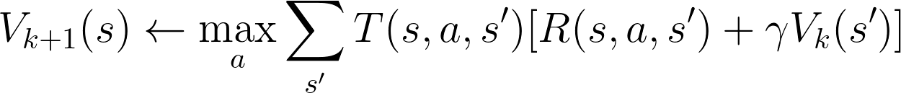
Value Iteration
Start with V₀ = 0
No time steps left means an expected reward sum of zero
Given vector of V_{k}(s) values, do one round of expectimax
V_{k+1}(s)
s
a
s,a
Repeat until convergence
Complexity
O(S²A)
Theorem
Converges to unique optimal values
s,a,s’
V_{k}(s)
s’

Slide 52

Quiz - Value Iteration
V₀( ) =
V₁( ) =
V₂( ) =
V₀( ) =
V₁( ) =
V₂( ) =
V₀( ) =
V₁( ) =
V₂( ) =
-10
+2
+1
+1
http://ai.berkeley.edu

Slide 53
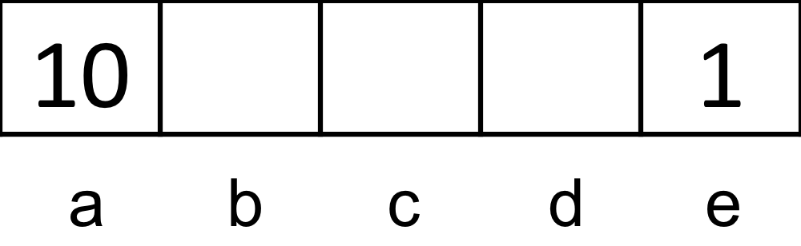
Quiz - V∞
Consider the same grid world as in the previous quiz (where east and west actions are successful 100% of the time)
γ = 0.2
Determine the following quantities
V∗(a) = V∞(a)
V∗(b) = V∞(b)
V∗(c) = V∞(c)
V∗(d) = V∞(d)
V∗(e) = V∞(e)

Slide 54
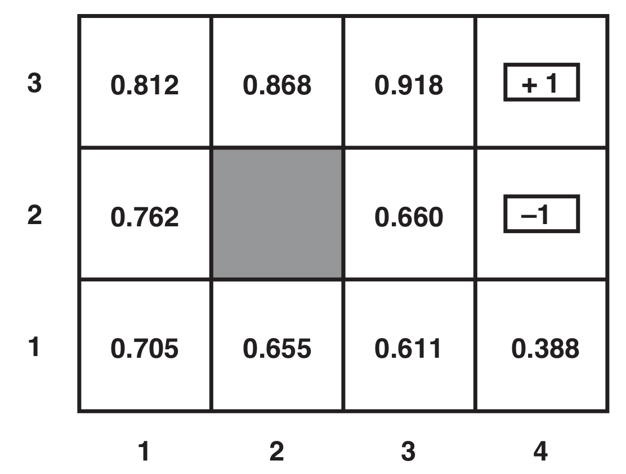
Quiz - Convergence
Consider the following example where γ = 1.0 and R(s) = -0.04
Show that the value at (3,3) has converged

Slide 55
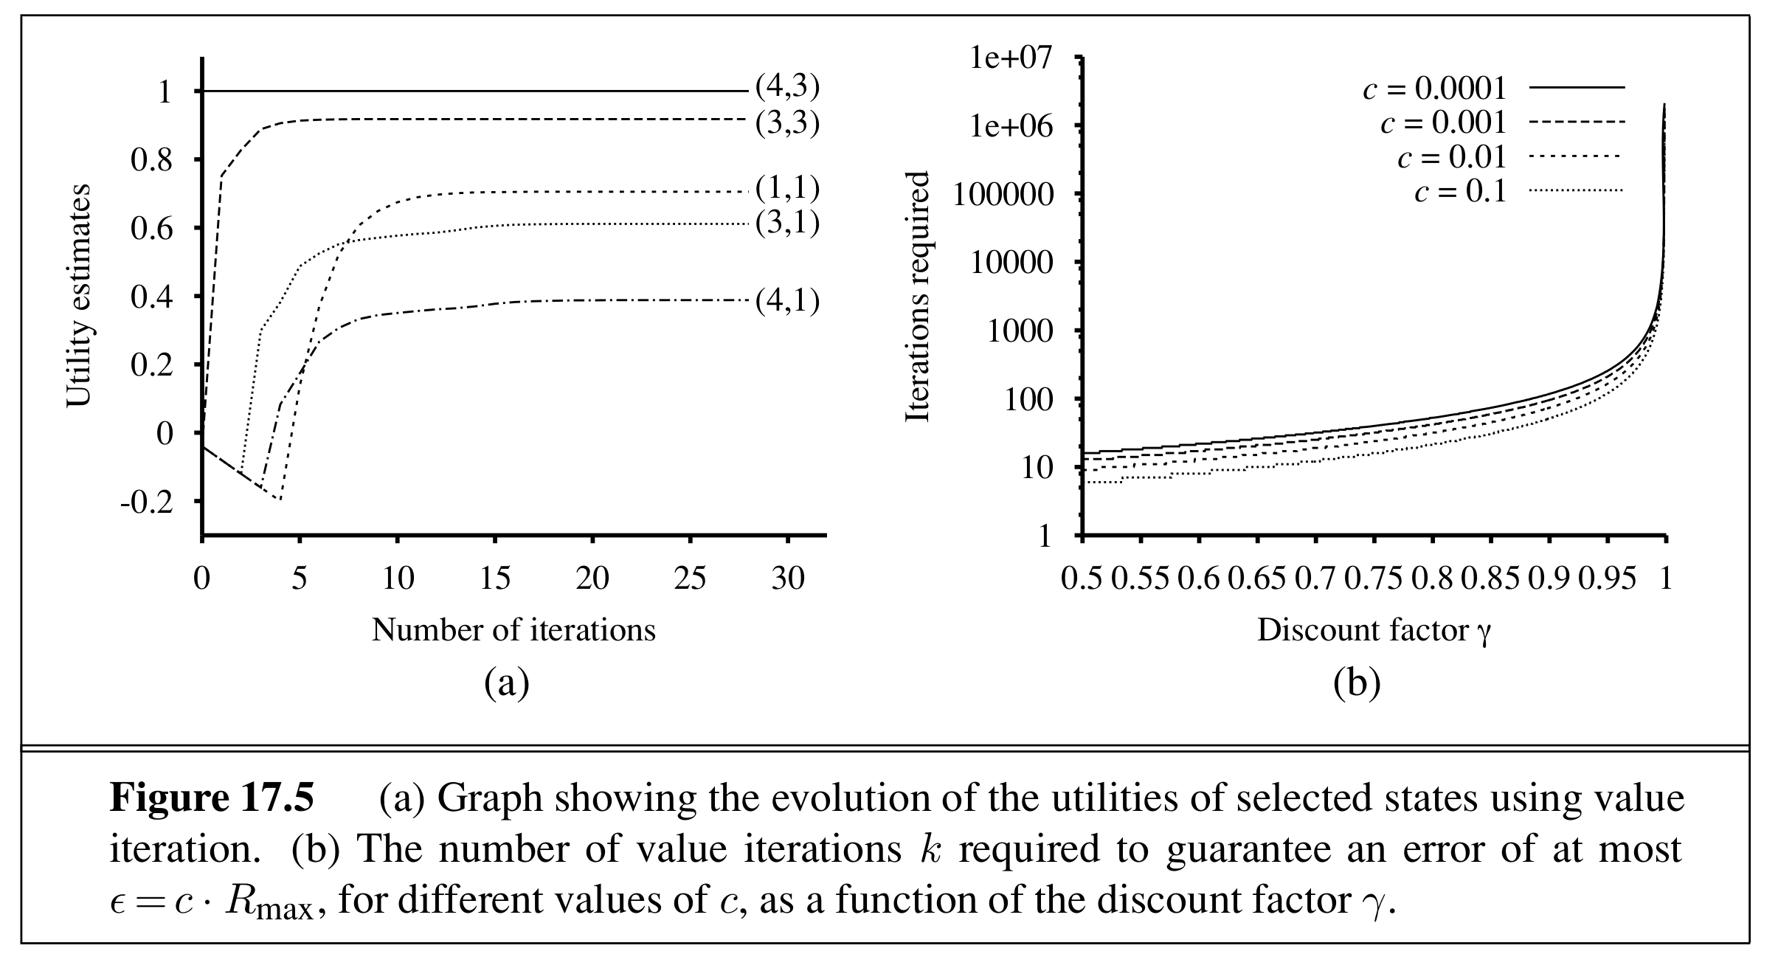
Evolution of Utilities / # Iterations vs. Gamma

Slide 56
Quiz - V_{k+1}(B)
s | a | s' | T(s,a,s') | R(s,a,s')
A | CW | B | 1.0 | 1.0
A | CCW | B | 0.4 | -2.0
A | CCW | C | 0.6 | -1.0
B | CW | A | 0.6 | 1.0
B | CW | C | 0.4 | 2.0
B | CCW | A | 0.2 | 1.0
B | CCW | C | 0.8 | -1.0
C | CW | A | 0.6 | -2.0
C | CW | B | 0.4 | 1.0
C | CCW | A | 0.4 | 0.0
C | CCW | B | 0.6 | 1.0
Consider the following transition and reward functions for an MDP with γ = 0.5
Suppose that after iteration k of value iteration we end up with the following values for V_{k}
V_{k}(A) = 1.7, V_{k}(B) = 1.82, V_{k}(C) = 1.22
What is V_{k+1}(B)?
Now, suppose that we ran value iteration to completion and found the following value function
V*(A) = 2.208, V*(B) = 2.416, V*(C) = 1.766
What is Q∗(B, CW) ?
What is Q∗(B, CCW) ?
What is the optimal action from state B ?

Slide 57
Quiz
Consider the transition and reward function shown in the table for an MDP that has two states and two actions
Let γ = 1.0
Determine the following
V₀(A), V₀(B)
Q₁(A,0), Q₁(A,1), Q₁(B,0), Q₁(B,1)
V₁(A), V₁(B)
Q₂(A,0), Q₂(A,1)
V₂(A)
s | a | s' | T(s,a,s') | R(s,a,s')
A | 0 | A | 0.5 | 2
A | 0 | B | 0.5 | -1
A | 1 | A | 0.5 | 1
A | 1 | B | 0.5 | 2
B | 0 | A | 0.0 | -2
B | 0 | B | 1.0 | -1
B | 1 | A | 0.1 | -3
B | 1 | B | 0.9 | -1

Slide 58
Bellman Equation vs. Value Iteration
Bellman equations characterize the optimal values
s
a
Value iteration computes them
s,a
s,a,s’
s’

Slide 59
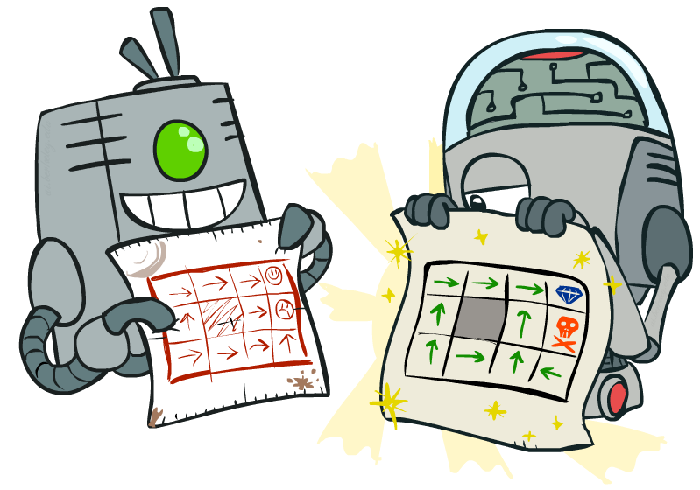
Policy Methods
http://ai.berkeley.edu

Slide 60

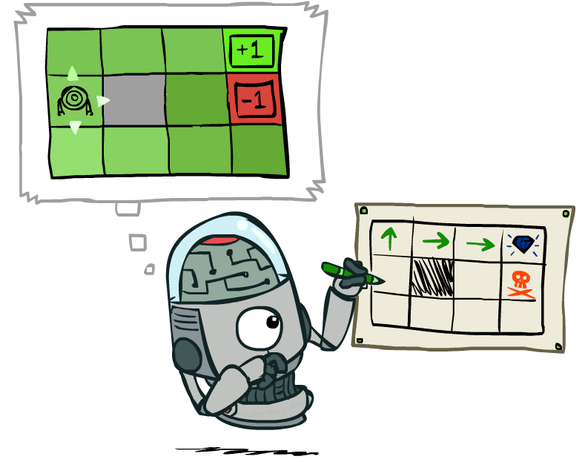

Policy Evaluation
Policy Iteration
http://ai.berkeley.edu
Policy Extraction

Slide 61
Policy Evaluation

Slide 62
Policy Evaluation
We would like to determine how good a given a policy π is
How well will I perform if I follow π ?
Do the optimal action
Do what π says
s
s
a
π(s)
s,a
s,π(s)
s,a,s’
s,π(s),s’
s’
s’

Slide 63
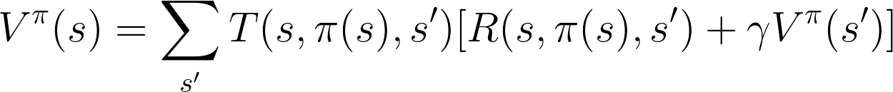
Utilities for a Fixed Policy
We compute the utility of a state s under a fixed (generally non-optimal) policy
V^{π}(s) = expected total discounted rewards starting in s and following π
s
π(s)
s,π(s)
s,π(s),s’
s’

Slide 64
New Example
-10 | 100 | -10
-10 |  | -10
-10 |  | -10
-10 |  | -10

Slide 65
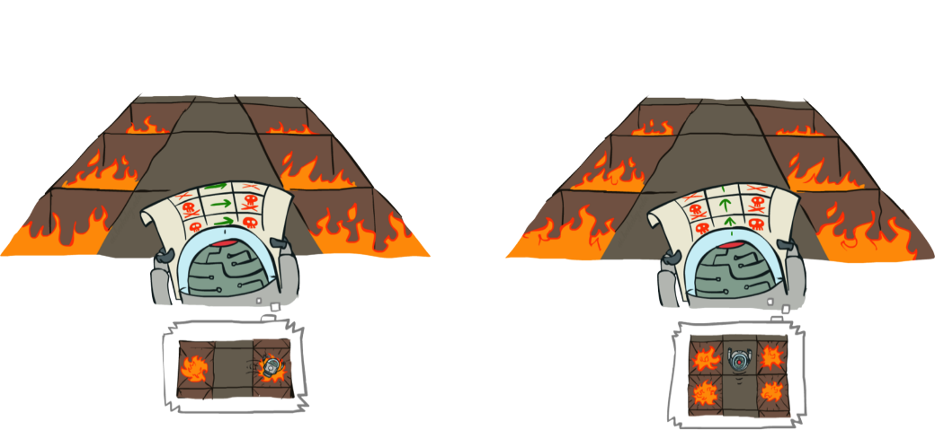
Example: Policy Evaluation
http://ai.berkeley.edu

Slide 66
Quiz - Go East
-10 | 100 | -10
-10 |  | -10
-10 |  | -10
-10 |  | -10
1.1
V^{π}(s) = ?
-7.9
-8.7
R(s) = 0.00
𝛄 = 0.90

Slide 67
Quiz - Go North
V^{π}(s) = ?
-10 | 100 | -10
-10 |  | -10
-10 |  | -10
-10 |  | -10
70.2
48.7
33.3
R(s) = 0.00
𝛄 = 0.90

Slide 68
Example: Policy Evaluation
-10 | 100 | -10
-10 |  | -10
-10 |  | -10
-10 |  | -10
-10 | 100 | -10
-10 |  | -10
-10 |  | -10
-10 |  | -10
70.2
1.1
-7.9
48.7
33.3
-8.7
R(s) = 0.00
𝛄 = 0.90

Slide 69
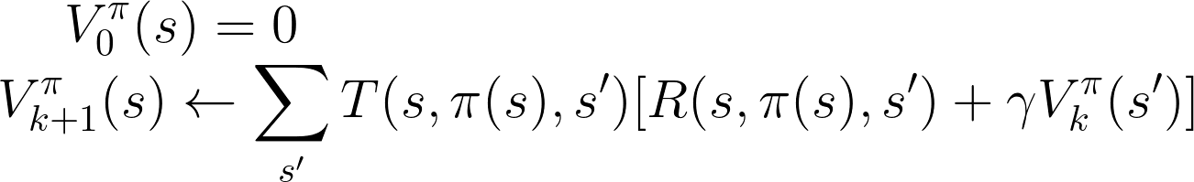
Policy Evaluation
How do we calculate the V’s for a fixed policy π ?
Idea 1: Turn recursive Bellman equations into updates (like value iteration)
Efficiency: O(S²) per iteration
Idea 2: Without the max, the Bellman equations are just a linear system
Use a linear system solver

Slide 70
Quiz - Policy Evaluation
Consider the same grid world as in the previous quiz, where east and west actions are successful 100% of the time and γ = 1
Consider the policy π
Evaluate the values for all states
Consider the policy π’
Evaluate the values for all states
exit |  |  |  | exit

Slide 71
Policy Extraction
http://ai.berkeley.edu

Slide 72
Policy Extraction
Let’s imagine we have the optimal values V*(s)
0.95 | 0.97 | 0.98 | +1
0.94 |  | 0.89 | -1
0.93 | 0.92 | 0.90 | 0.82
How should we act?
We need to do a mini-expectimax (one step)
This is called policy extraction, since it gets the policy implied by the values

Slide 73

Policy Extraction
Let’s imagine we have the optimal q-values
How should we act?
0.94
0.95
0.97
+1
0.94
0.95
0.94
0.96
0.95
0.98
0.93
0.95
0.90
0.94
0.76
-1
0.93
0.93
0.89
-0.62
0.92
0.70
0.92
0.90
0.87
-0.64
0.91
0.90
0.91
0.89
0.90
0.81
0.69
0.61
0.91
0.90
0.88
0.80
Super easy:
Actions are easier to select from q-values than values

Slide 74
Can we improve the runtime of value iteration?

Slide 75
Value Iteration - V₀
0.00
0.00
0.00
0.00
0.00
0.00
0.00
R(s) = -0.10
𝛄 = 1.0
0.00
0.00
0.00
0.00

Slide 76
Value Iteration - V₁
-0.10
-0.10
-0.10
1.00
-0.10
-0.10
-1.00
R(s) = -0.10
𝛄 = 1.0
-0.10
-0.10
-0.10
-0.10

Slide 77
Value Iteration - V₂
-0.20
-0.20
0.68
1.00
-0.20
-0.20
-1.00
R(s) = -0.10
𝛄 = 1.0
-0.20
-0.20
-0.20
-0.20

Slide 78
Value Iteration - V₃
-0.30
0.40
0.75
1.00
-0.30
0.32
-1.00
R(s) = -0.10
𝛄 = 1.0
-0.30
-0.30
-0.30
-0.30

Slide 79
Value Iteration - V₄
0.16
0.58
0.81
1.00
-0.40
0.43
-1.00
R(s) = -0.10
𝛄 = 1.0
-0.40
-0.40
0.10
-0.40

Slide 80
Value Iteration - V₅
0.34
0.66
0.82
1.00
-0.05
0.49
-1.00
R(s) = -0.10
𝛄 = 1.0
-0.50
-0.10
0.16
-0.16

Slide 81
Value Iteration - V₆
0.46
0.69
0.83
1.00
0.16
0.51
-1.00
R(s) = -0.10
𝛄 = 1.0
-0.20
0.01
0.26
-0.08

Slide 82
Value Iteration - V₇
0.52
0.70
0.83
1.00
0.30
0.52
-1.00
R(s) = -0.10
𝛄 = 1.0
0.01
0.11
0.30
0.00

Slide 83
Value Iteration - V₈
0.54
0.71
0.83
1.00
0.37
0.52
-1.00
R(s) = -0.10
𝛄 = 1.0
0.15
0.16
0.32
0.04

Slide 84
Value Iteration - V₉
0.56
0.71
0.84
1.00
0.41
0.52
-1.00
R(s) = -0.10
𝛄 = 1.0
0.23
0.19
0.34
0.06

Slide 85
Value Iteration - V₉
0.56
0.71
0.84
1.00
0.41
0.52
-1.00
R(s) = -0.10
𝛄 = 1.0
0.23
0.19
0.34
0.06

Slide 86
Value Iteration - V₁₀₀
0.57
0.71
0.84
1.00
0.44
0.52
-1.00
R(s) = -0.10
𝛄 = 1.0
0.31
0.22
0.35
0.09

Slide 87
Properties of Value Iteration
Slow
O(S²A) per iteration
Max at each state rarely changes
The policy often converges long before the values

Slide 88
Policy Iteration
http://ai.berkeley.edu

Slide 89
Policy Iteration
Policy iteration is an alternative approach for optimal values
Policy evaluation: calculate utilities for some fixed policy (not optimal utilities!) until convergence
Policy improvement: update policy using one-step look-ahead with resulting converged (but not optimal!) utilities as future values
Repeat steps until policy converges
Still optimal
Can converge (much) faster under some conditions

Slide 90
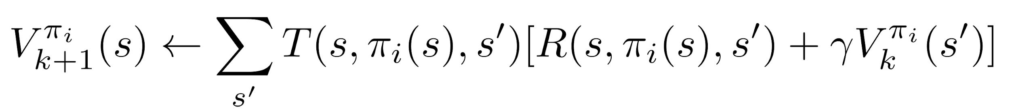
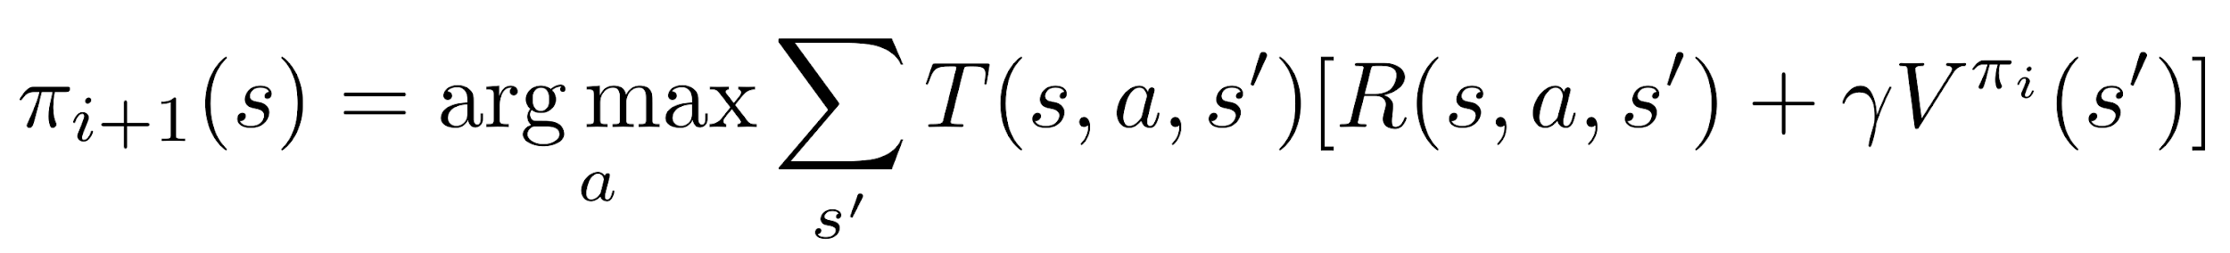
Policy Iteration
Evaluation: For fixed current policy π, find values with policy evaluation
Iterate until values converge
Improvement: For fixed values, get a better policy using policy extraction
One-step look-ahead

Slide 91
Quiz - Policy Iteration
Consider the same grid world as in the previous quiz, where east and west actions are successful 100% of the time
𝛄 = 0.9
We will execute one round of policy iteration
Consider the policy π_{i} shown below
Evaluate the following quantities
Policy evaluation:
Policy improvement:
exit |  |  |  | exit

Slide 92
Comparison
Both value iteration and policy iteration compute the same thing (all optimal values)
In value iteration
Every iteration updates both the values and (implicitly) the policy
We don’t track the policy, but taking the max over actions implicitly recomputes it
In policy iteration
We do several passes that update utilities with fixed policy (each pass is fast because we consider only one action, not all of them)
After the policy is evaluated, a new policy is chosen (slow like a value iteration pass)
The new policy will be better (or we’re done)
Both are dynamic programs for solving MDPs

Slide 93
Summary: MDP Algorithms
So you want to….
Compute optimal values: use value iteration or policy iteration
Compute values for a particular policy: use policy evaluation
Turn your values into a policy: use policy extraction (one-step lookahead)
These all look the same!
They basically are – they are all variations of Bellman updates
They all use one-step lookahead expectimax fragments
They differ only in whether we plug in a fixed policy or max over actions

Slide 94
MDP vs. RL
next chapter

Slide 95
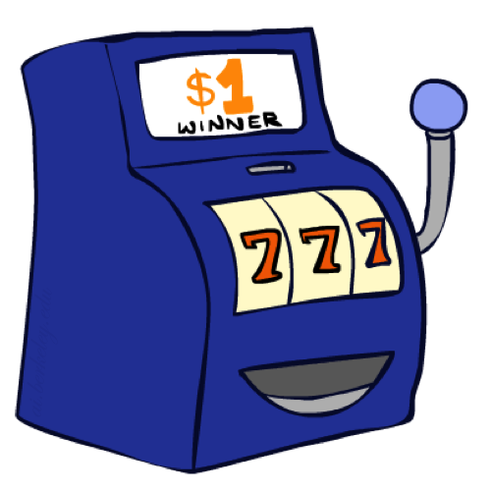
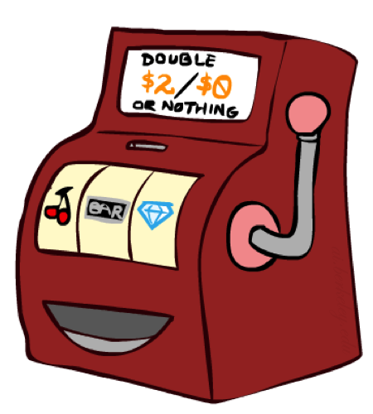

Double-Bandits
http://ai.berkeley.edu

Slide 96
Double-Bandits
An agent can play two slot machines
Blue, or Red
You receive $1
You receive $0 or $2, 25% and 75% of the time, respectively
What should the agent do?
http://ai.berkeley.edu

Slide 97
Double-Bandits MDP
Actions: Blue and Red
States: Win, Lose
Assumption:
No discount
100 time steps
$1
100%
$0
25%
$2
75%
W
L
$2
75%
$1
100%
$0
25%

Slide 98
Offline Planning
Solving MDPs is offline planning
We determine all quantities through computation
We need to know the details of the MDP
We do not actually play the game
$1
100%
$0
25%
$2
75%
W
L
$2
75%
$1
100%
$0
25%

Slide 99
Let’s Play!
$2
$0
$2
$2
$0
$0
http://ai.berkeley.edu

Slide 100
Rules Changed!
$1
100%
$0
?%
$2
?%
W
L
$2
?%
$1
100%
$0
?%

Slide 101
Let’s Play!
$1
$0
$0
$0
$0
$0
$2
http://ai.berkeley.edu

Slide 102
What Just Happened ?
That wasn’t planning, it was learning
Specifically, reinforcement learning
There was an MDP, but you couldn’t solve it with just computation !
You needed to actually act to figure it out
Important ideas in reinforcement learning that came up
Exploration: you have to try unknown actions to get information
Exploitation: eventually, you have to use what you know
Regret: even if you learn intelligently, you make mistakes
Sampling: because of chance, you have to try things repeatedly
Difficulty: learning can be much harder than solving a known MDPs

